Slide 1

26 kweyeDwarha 2022
Iziganeko-Intshayelelo malunga nendima yee-EHP
Inkcazo-ntetho nguHEC

Slide 2
UMasipala weSithili saseGarden Route, isithili esikhokelayo, esivumelayo nesibandakanyayo, esiphawulwa ngophuhliso olulinganayo noluzinzileyo, umgangatho ophezulu wobomi namathuba alinganayo kumntu wonke.
www.gardenroute.gov.za

Slide 3
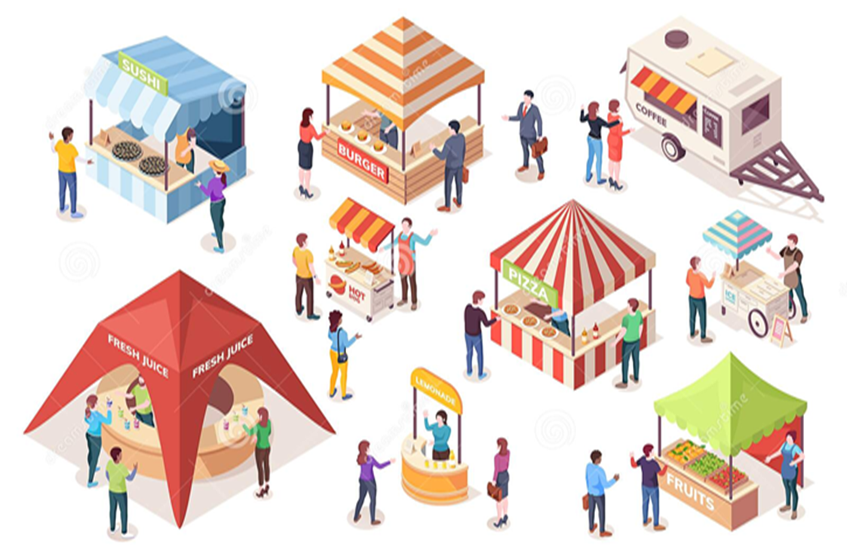
Ulwandlalo Lwentetho
Yintoni iMpilo yokuSingqongileyo
Umda woMsebenzi
Umthetho
Indawo yokutya
Izindlu zangasese zoLuntu
Izibonelelo zenkunkuma
Izilwanyana kwimisitho

Slide 4
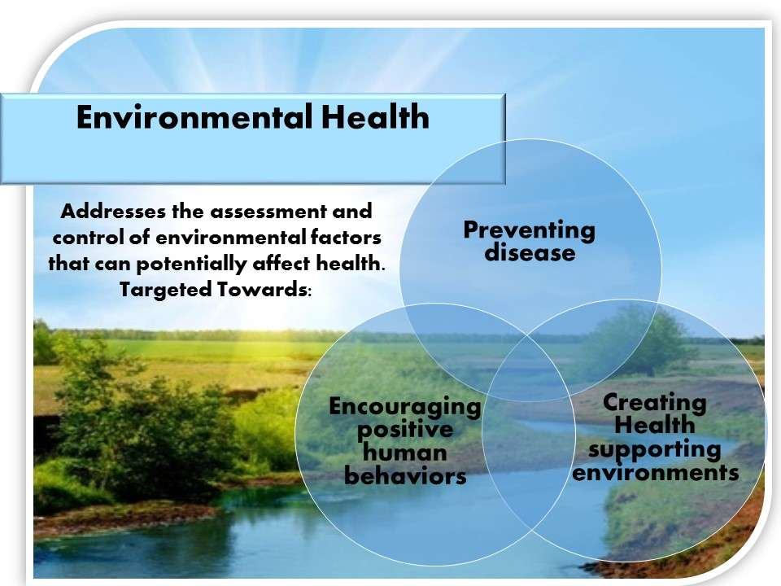
Yintoni iMpilo yokuSingqongileyo?
Ngokutsho kweWorld Health Organization impilo yokusiNgqongileyo ibandakanya ezo nkalo zempilo yabantu, kuquka nomgangatho wobomi, ezimiselwa ngumzimba, iikhemikhali, zebhayoloji, zentlalo kunye neemeko zengqondo ngokusingqongileyo. Ikwabhekiselele kwithiyori kunye nokuziqhelanisa nokuvavanya, ukulungisa, ukulawula kunye nokuthintela ezo zinto kwimo esingqongileyo ezinokuchaphazela kakubi impilo yesizukulwana sangoku nesexesha elizayo. Ukuphawula, ukuvavanywa, ulawulo kunye nokuthintela ngokufundisa ngazo zonke ezo zinto kwimo esingqongileyo inganefuthe elibi kuwe emzibeni, ngokwasengqonweni, kunye nokuhlala kakuhle kunye nophuhliso. Ikwathetha ukuqhubeka ngenzame zokufundisa nokuthintela abantu ukuba benze okusingqongileyo ngendlela yokuba ibe yingozi kubo intlalontle nophuhliso.

Slide 5

Umthetho
Igosa lezempilo lokusingqongileyo liqeshwa ngokwecandelo 80 lomthetho wezempilo kazwelonke, ka 2003 (umthetho 61 ka-2003).
Siqeshwe njengomhloli ngokwecandelo le-10 lomthetho wezinto zokutya, izinto zokuthambisa kunye nezibulali ntsholongwane, wango 1972 (umthetho wama-54 ka-1972).
Sigunyaziswe ukuba senze imisebenzi wenkonzo yezempilo kamasipala njengoko kuchaziwe kwicandelo loku-1 lomthetho wezempilo kazwelonke, ka-2003 (uMthetho 61 ka-2003) nokusebenzisa wonke umthetho ofanelekileyo kulo msebenzi..
Igosa lezempilo lokusingqongileyo nalo liqeshwe ngokwemiqathango ye icandelo 334(1)(a) lomthetho wenkqubo yolwaphulo-mthetho 1977(umthetho 51 ka-1977) ifundwe kunye ne-GN NO.R159 yomhla wesi-2 kweyoMdumba njengegosa lonyanzeliso lomthethi.

Slide 6
Umda woMsebenzi
Umda wokuziqhelanisa nomsebenzi wezempilo wokusingqongileyo ubandakanya oku kulandelayo:
1. Umgangatho waManzi kunye noKhuseleko
2. Ukulawulwa kokutya
3. Ulawulo lweNkunkuma
4. Ukuhlolwa kweMpilo kwiNdawo
5. Ukubek'esweni kunye nothintelo lwezifo ezosulelayo, ngaphandle kogonyo
6. Ulawulo lweVector (Ukulawulwa kwezinambuzane ezisasaza izifo)
7. Ukulawula Ungcoliseko
8. Ukulahlwa kwabafileyo( Ukugcwatywa kwezidumbu)
9. Ukhuseleko lwekhemikhali.(Ukusetyenziswa kwetyhefu ngokukhuselekileyo)
Ngaphandle kweMpilo yeZibuko, uLawulo lweMalariya kunye nokulawulwa kwezinto ezinobungozi

Slide 7
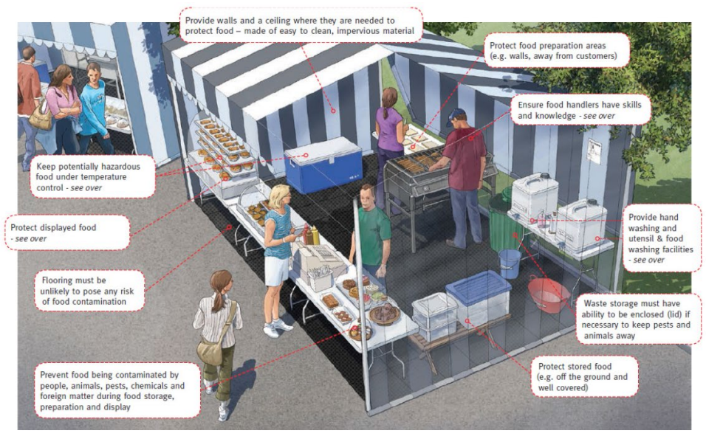
Izitali
Ngaba uyazibona iimfuno ezingekhoyo emfanekisweni?

Slide 8
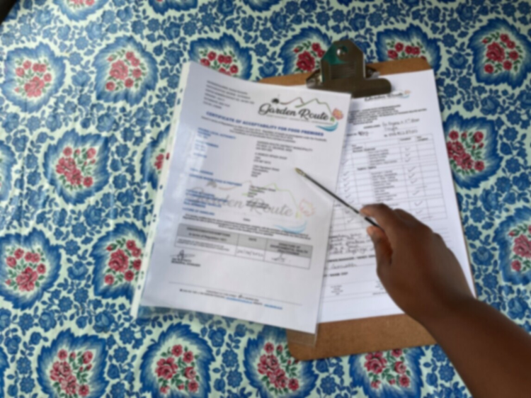
Indawo yokutya
IMimiselo eLawula iiMfuno zoCoceko ngokuBanzi kwiiNdawo zokuTya, ukuThuthwa kokuTya kunye neMiba eNxulumeneyo, i-R638 ka-2018, ebhengezwe phantsi koMthetho wokuTya, izithambiso kunye neziTyalo zokubulala iintsholongwane uMthetho wama-54 ka-1972.
I-R638 yonyaka ka -2018 ichaza ezona mfuno zisezantsi kwindawo yokutya kufuneka zithotyelwe kwaye ihambelane nayo..
Ukuthotyelwa kwe-R638 yonyaka ka-2018 akuthethi mvume ukuqhuba ishishini kwindawo yokutya ngaphandle kokuthobela zonke ezinye iimfuno ezifanelekileyo zikamasipala okanye umthetho osebenzayo.

Slide 9
Indawo yokutya
Ngaba uyazibona iimfuno ezingekhoyo emfanekisweni?

Slide 10

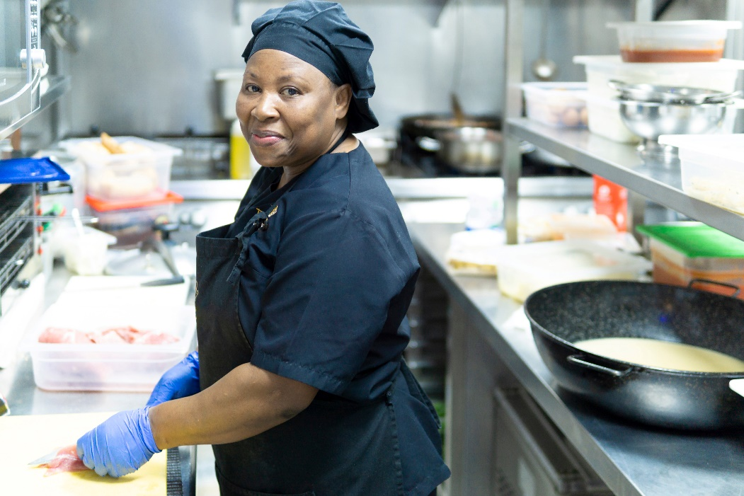
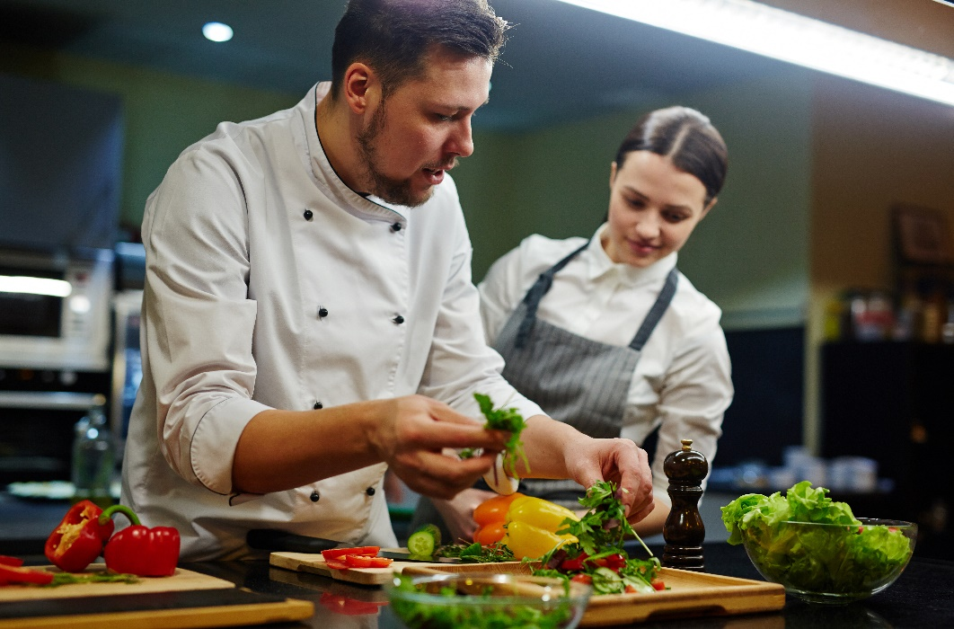


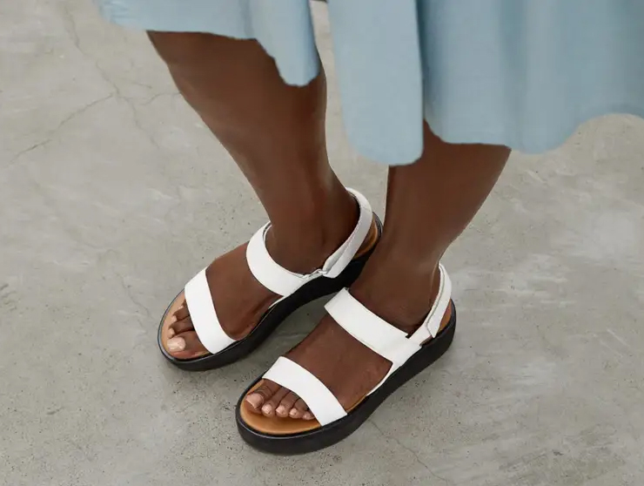
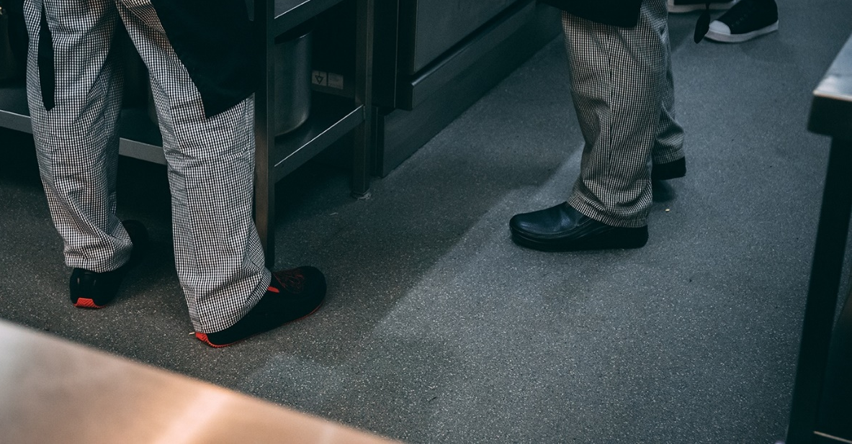
Izixhobo zoKhuseleko zobuqu

Slide 11
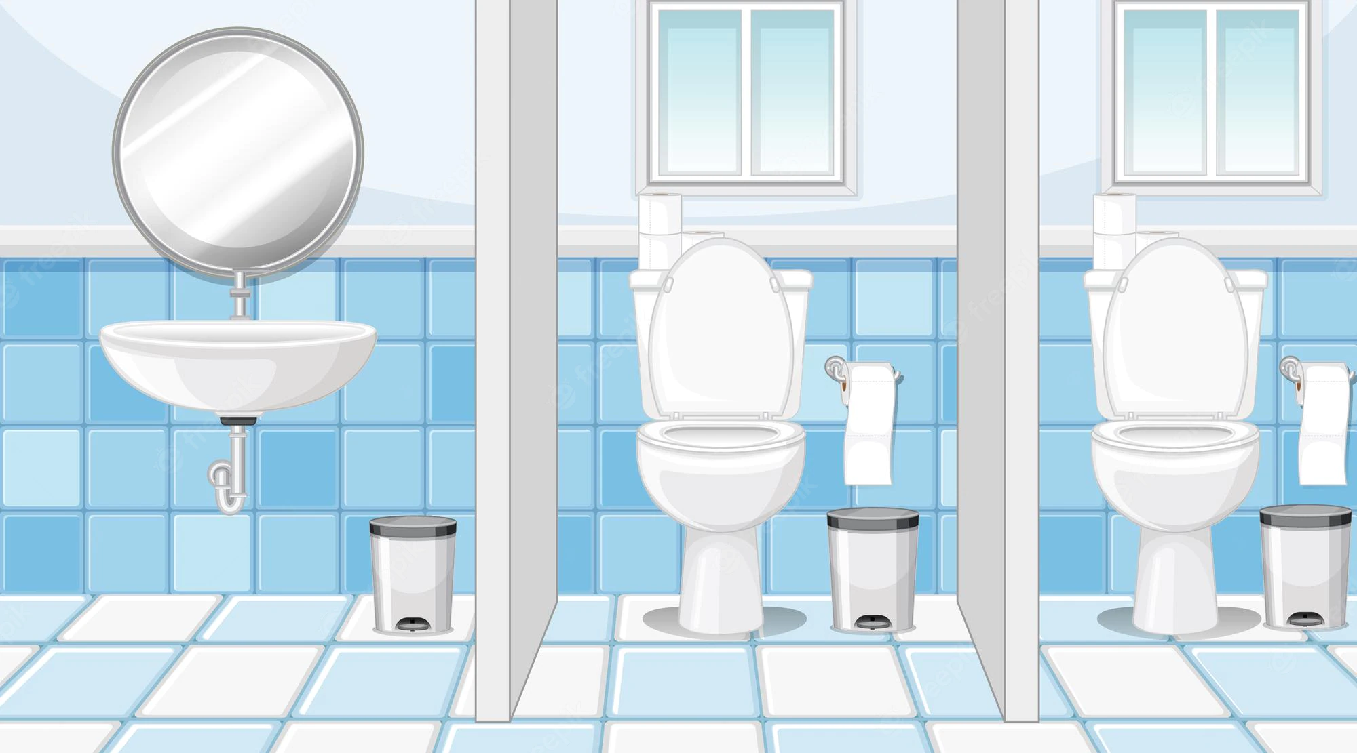
Izindlu zangasese zoLuntu
• Izindlu zangasese zikawonke-wonke kufuneka zixhotyiswe ngenkqubo yokugungxulwa eyaneleyo kunye nazo zonke izindlu zangasese, kwaye kufuneka zigcinwe zikwimeko entle yokusebenza.
• Izindlu zangasese zikawonke-wonke kufuneka zigcinwe zicocekile ngawo onke amaxesha, imigangatho ikhuhlwe kwaye izitya zicocwe kwaye zibulawe iintsholongwane yonke imihla.
• Indlu yangasese eyaneleyo nefikelelekayo, indawo yokuhlambela kunye nebhafu kufuneka ilungiselelwe uluntu
• Imigangatho yegumbi lokuhlambela kunye nezixhobo zangasese kufuneka zakhiwe ngomphezulu ongatyibiliki.
• Iindonga zezindlu zangasese kufuneka zakhiwe ngendlela egudileyo kwaye zibe nombala okhanyayo.
• Izindlu zangasese kufuneka zikhanyise ngokwaneleyo kwaye zingrnr umoya..
• Izindlu zangasese kufuneka zilungiselelwe isini ngasinye.

Slide 12

Izixhobo zeNkunkuma
• Ukuqokelelwa, ukugcinwa nokulahlwa kwenkunkuma ngokubanzi, kufuneka kulawulwe ngokuhambelana nemfuno njengoko kuchaziwe kwiCandelo U leNational Building Regulations kunye neCandelo 2-5 leMimiselo kunye neMigangatho yoLawulo lweNkunkuma;
• Indawo yenkunkuma evunyiweyo kufuneka ibonelelwe kulo ndawo ukuze kugcinwe kuyo yonke inkunkuma elindele ukususwa;
• Ukufikelela kwindawo yogcino lwenkunkuma kufuneka kubekelwe umda kufikelele kuphela abasebenzi abaqeqeshiweyo malunga nokukusebenza kwindawo yenkunkuma;
• Inani elaneleyo lemigqomo yenkunkuma kufuneka libonelelwe ukuze kugcinwe inkunkuma ngokubanzi kwindawo leyo.
• I-EHP iphinda ilandele umkhondo wokulahlwa kwenkunkuma ebeka impilo emngciphekweni ngokungekho mthethweni
• Apho inkunkuma ebeka impilo emngciphekweni ibandakanyekayo kufuneka kubekho umniki-nkonzo otyunjiweyo ozakuyiqokelela lenkunkuma ebeka impilo emngciphekweni.
• Ngexesha lokuhlolwa kweendawo zokutya kunye nezinye iindawo zikawonke-wonke
abasebenzi bempilo yokusingqongileyo baqinisekisa ukuba amanzi amdaka ayalahlwa
ngokwanelisa umasipala ochaphazelekayo.

Slide 13
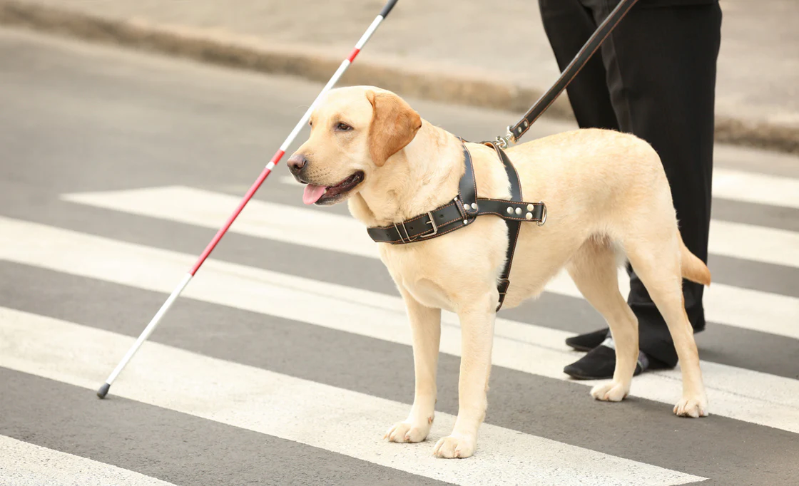
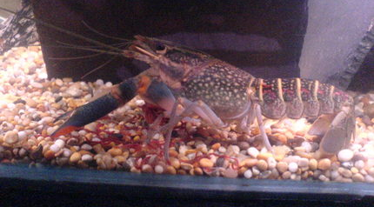
Izilwanyana kwimisitho
Izilwanyana akuvumelekanga okanye azivumelekanga kwindawo yokutya.
Eyona nto ivumelekileyo ngumkhokeli okanye inja yenkonzo ekhapha umntu onokukhubazeka kwaye inja inokuvunyelwa kwindawo yokuthengisa okanye yokuphakela kwindawo yokutya.
Intlanzi, iimolluscs okanye iicrustaceans zinokugcinwa ziphila de zilungiselelwe ukutyiwa.
Siyanikhuthaza ukuba nizahlule iindawo zokutyela kunye neendawo apho izinja zivumelekileyo.

Slide 14
