Slide 1

Events – Introduction about the role of EHP’s
Version 1.1

Slide 2
Garden Route District Municipality,
the leading, enabling and inclusive district, characterised by equitable and sustainable development, high quality of life and equal opportunities for all.
www.gardenroute.gov.za

Slide 3

Outline of Presentation
What is Environmental Health
Scope of Profession
Legislation
Food Premises
Public Toilets
Waste facilities
Animals at events

Slide 4
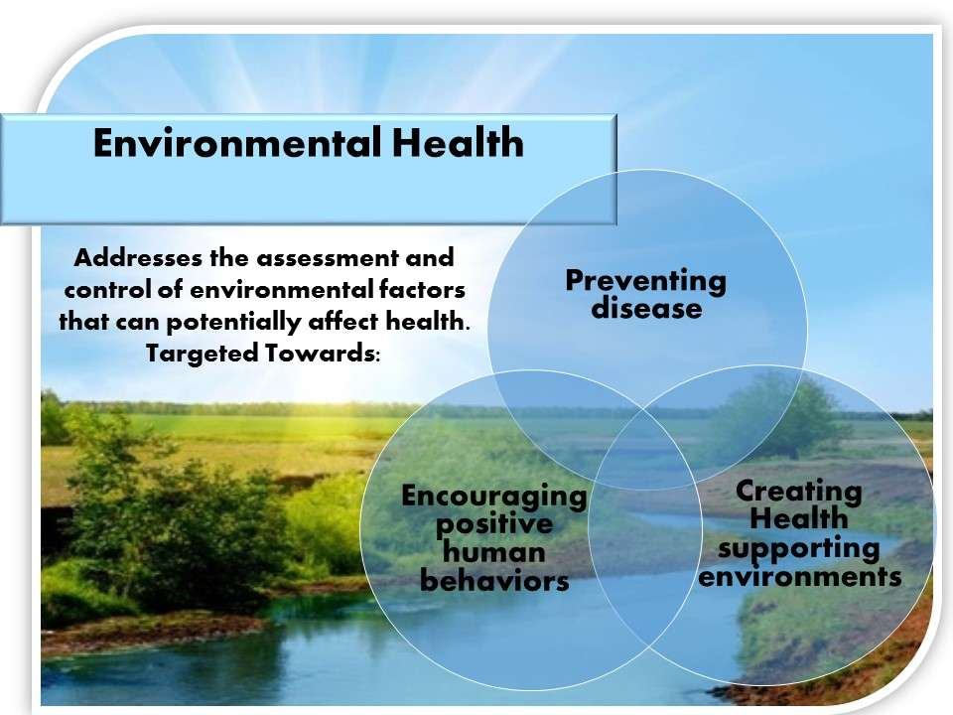
What is Environmental Health?
According to World Health Organisation Environmental health comprises those aspects of human health, including quality of life, that are determined by physical, chemical, biological, social and psychosocial factors in the environment. It also refers to the theory and practice of assessing, correcting, controlling and preventing those factors in the environment that can potentially affect adversely the health of present and future generations. The
identification, evaluation, control as well as prevention through
education of all those factors in the total environment which
exercise a detrimental effect on individual physical, mental and
social wellbeing and development. It also implies continuous
efforts to educate and prevent individuals from effecting the
environment in such a way that it becomes detrimental to their
wellbeing and development.

Slide 5

Legislation
Environmental health practitioner is appointed in terms of section
80 of national health act, 2003 (act 61 of 2003).
We are appointed an inspector in terms of section 10 of the
foodstuffs, cosmetics and disinfectants act, 1972 (act 54 of 1972).
We are authorised to execute the functions of municipal health
services as is defined in section 1 of the national health act, 2003
(act 61 of 2003) and to apply all legislation relevant to the function.
Environmental health practitioner also appointed in terms of
section 334(1)(a) of the criminal procedure act 1977(act 51 of 1977)
read in conjunction with GN NO R159 OF 2 February as a law
enforcement officer.

Slide 6
Scope of Profession
The scope of practice for environmental health practitioner includes the following:
1. Water Quality and Safety
2. Food Control
3. Waste Management
4. Health Surveillance of Premises
5. Surveillance and prevention of communicable diseases, excluding immunisations
6. Vector Control
7. Pollution Control
8. Disposal of the dead
9. Chemical safety.
Excluding Port Health, Malaria Control and control of Hazardous Substances

Slide 7
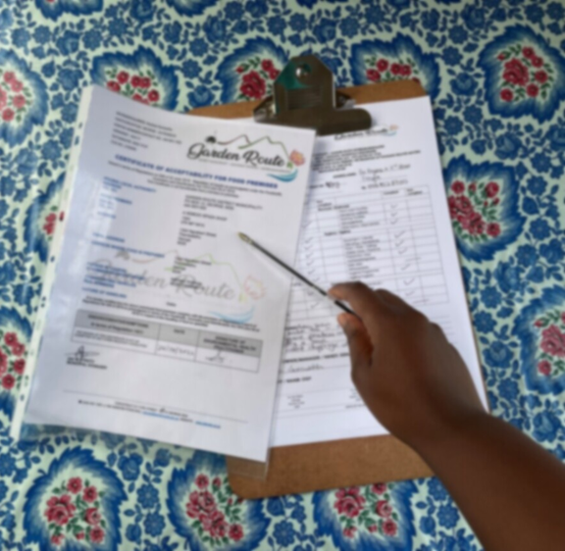
Food Premises
Regulations Governing General Hygiene Requirements for Food Premises, the Transport of Food and Related Matters, R638 of 2018, promulgated under the Foodstuffs, Cosmetics and Disinfectants Act 54 of 1972.
R638 of 2018 outlines the minimum requirements that food premises
must comply and conform to.
Compliance with R638 of 2018 does not constitute an approval
to conduct business on a food premises without complying with
all other relevant requirements of the local authority or the applicable
legislation.

Slide 8
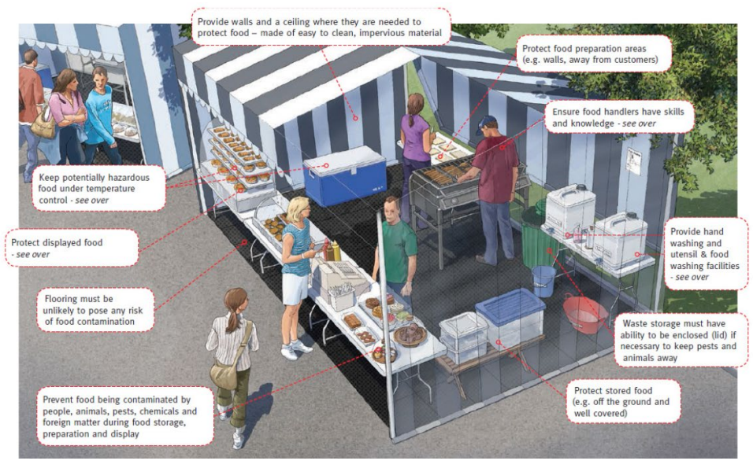
Food Premises
Can you spot the missing requirements in the picture?

Slide 9






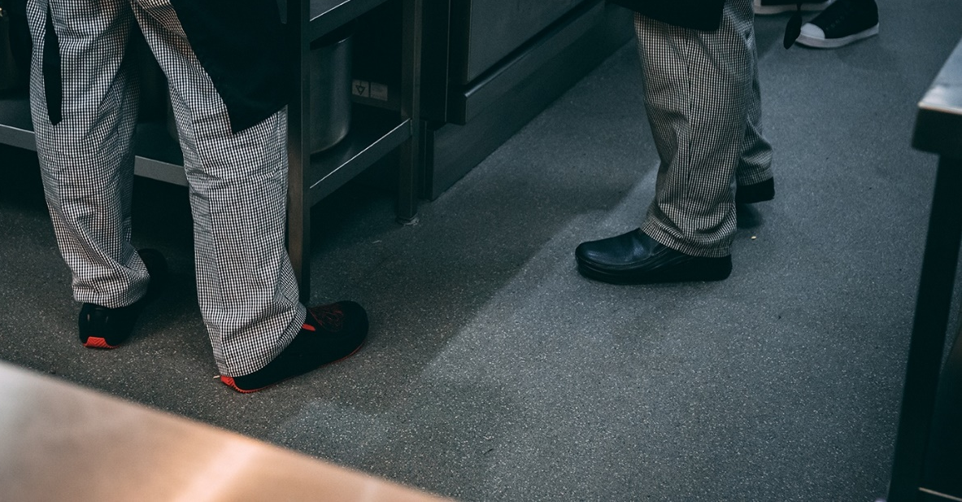
Personal Protective Equipment

Slide 10
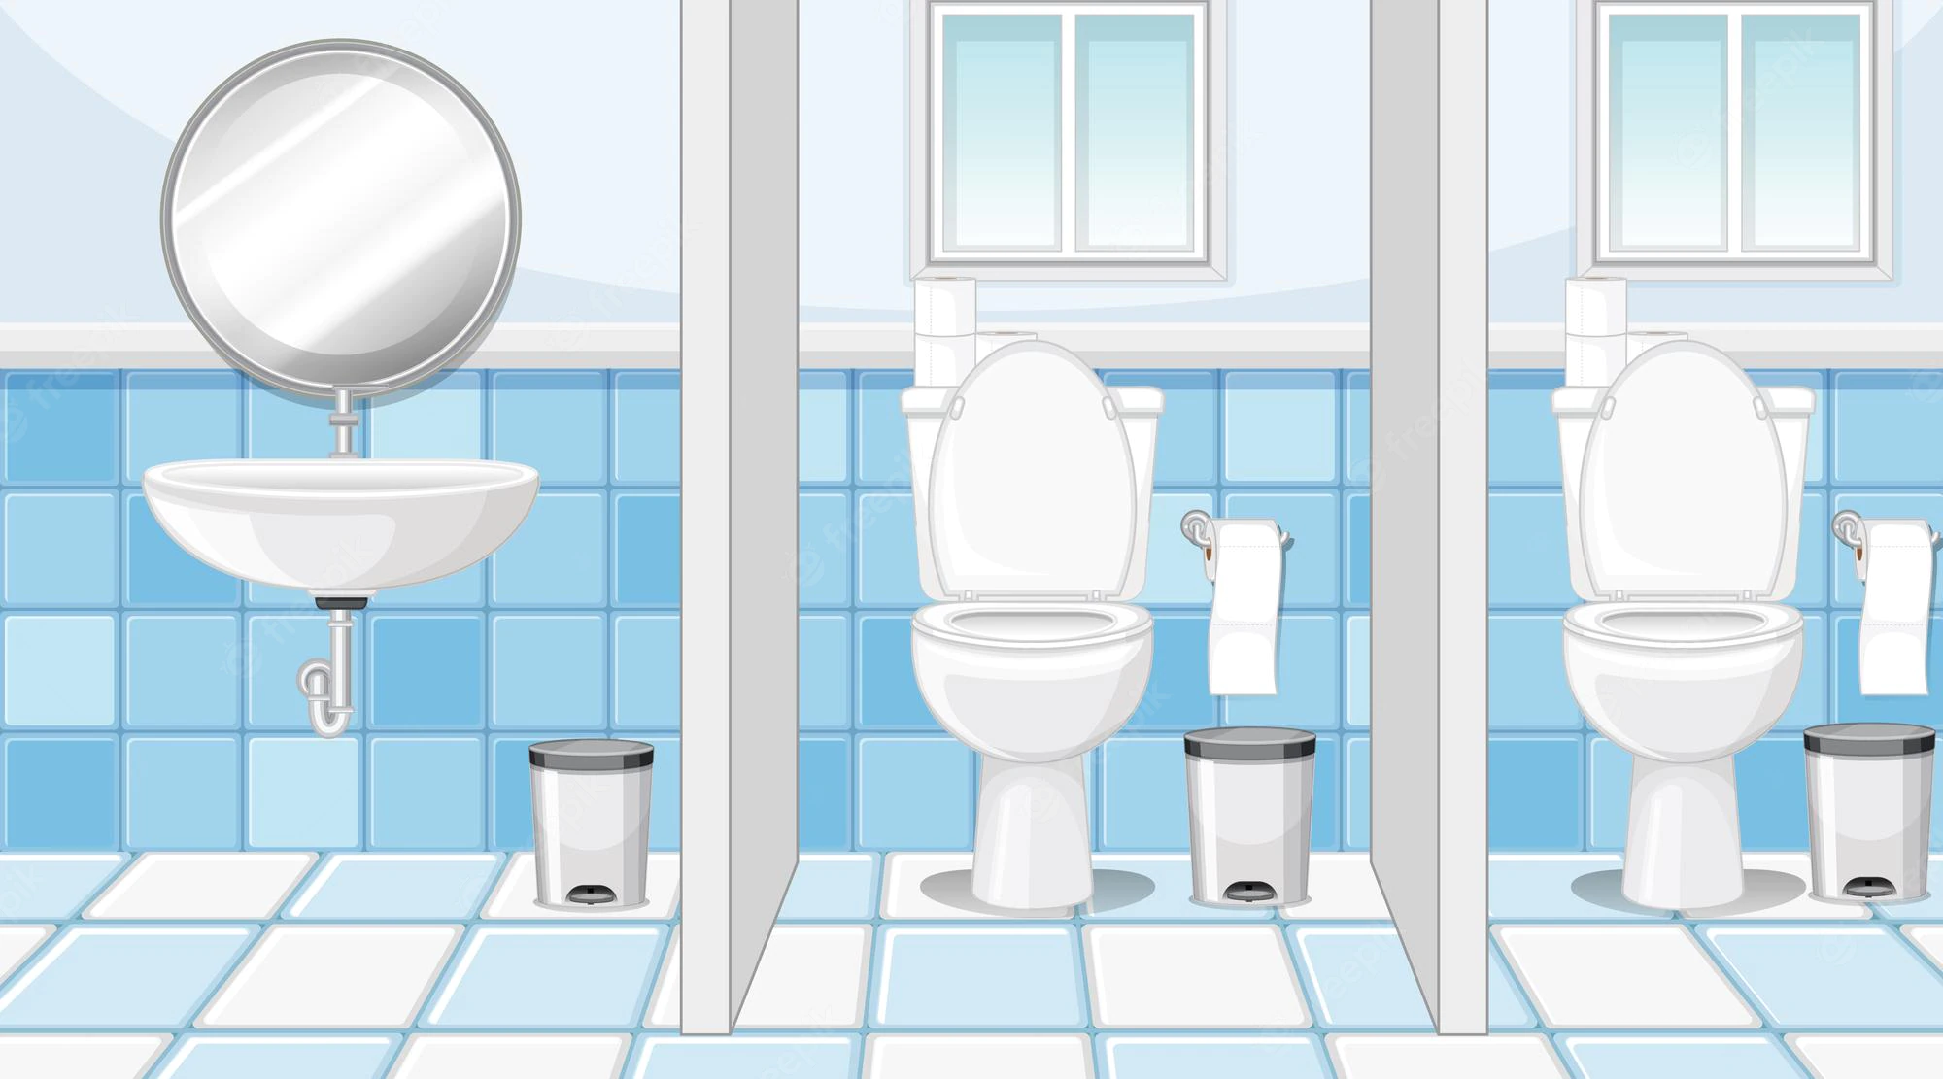
Public Toilets
• Public toilets must be equipped with an adequate flushing system and all toilets, and must be
maintained in good working order.
• Public toilets must be kept clean at all times, floors scrubbed and bowls cleaned and disinfected daily.
• Adequate and accessible toilet, wash-up and bath facilities must be provided for the public
• Floors of the bathroom and toilet facilities must be constructed of non-slippery surface.
• Walls of the toilet facilities must be constructed of a smooth surface and be light coloured.
• Toilet facilities must be adequately illuminated and ventilated.
• Toilets must be designated for each sex.

Slide 11

Waste Facilities
• The collection, storage and disposal of general waste, must be managed in accordance with the
requirements as specified in Part U of the National Building Regulations and Section 2-5 of the Norms
and Standards for Waste Management;
• An approved refuse area must be provided on the premises for the storage of all refuse pending removal;
• Access to waste storage facility must be limited to employees who have been trained with respect to the
operation of a waste facility;
• An adequate number of refuse bins must be provided for the storage of general waste on the premises.
• EHP also do contact tracing of illegal dumping of health care risk waste
• Where health care risk waste is involved there must be an appointed service provider for collection
of the health care risk waste.
• During the inspection of food premises and other public premises
environmental health practitioners ensures that waste water is disposed
of to the satisfaction of the relevant local authority.

Slide 12
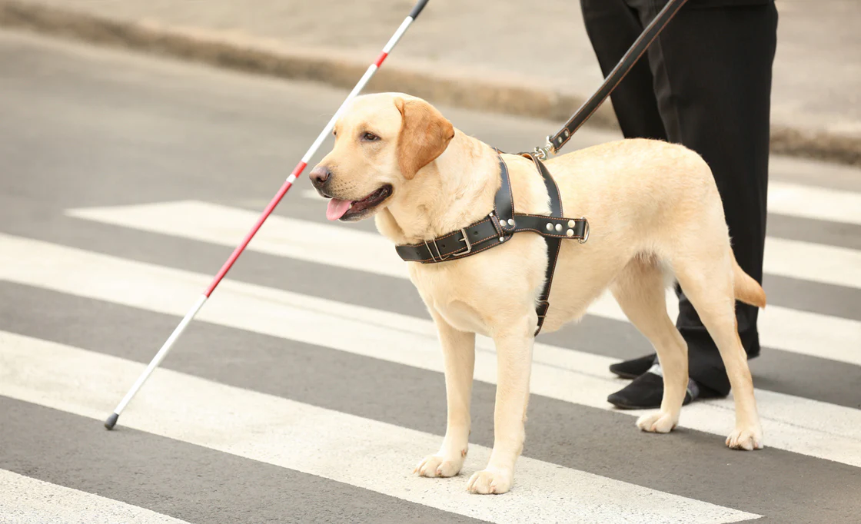
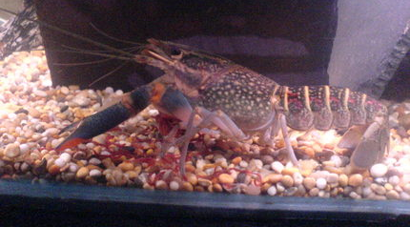
Animals at events
Animals are not allowed or permitted in a food premises.
The only exception is a guide or service dog accompanying a person with a disability and the dog may be permitted in the sales or serving area of the food premises.
Fish, molluscs or crustaceans may be kept alive until prepared for consumption.
We encourage you to separate food stalls and areas where dogs are allowed.

Slide 13


Slide 14



