Slide 1
Department of Health and Wellness
Garden Route District
IDP
23 November 2023

Slide 2
Presentation overview
1. Geographic Service Area Overview
2. Population Overview
3. Burden of Diseases
4. Garden Route District Health Services
5. Corporate Services
6. Contracting Units for Primary Health Care (CUP)
7. NHI aspects and Capital Projects
8. Inverter Projects

Slide 3
1. Geographic Services Area Overview

Slide 4
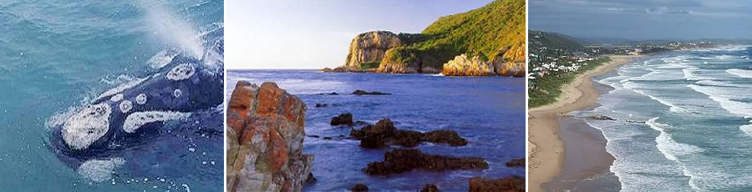

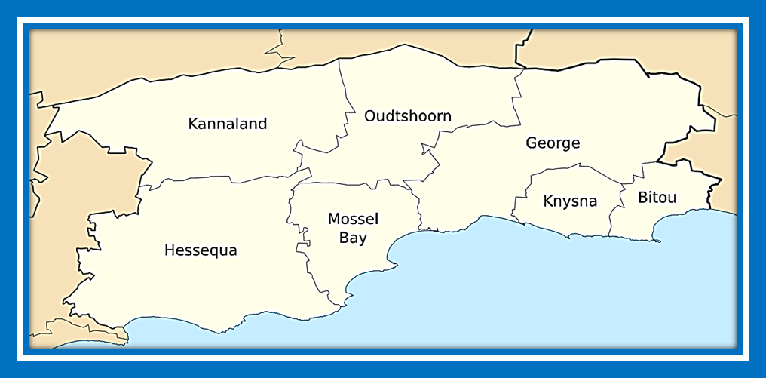

Slide 5
GSA (Geographic Service Area) Concept
There are 4 components of the health department in the district:
  DHS, George Regional Hospital, EMS/HealthNet & Forensic Pathology Services
The GSA is a functional arrangement to ensure the best possible services to the
population of both the Central Karoo and Garden Route even though not all
services report to the district office.
3. Active collaboration between the 4 components to plan and implement
services

Slide 6

Service Platform

Slide 7
2. Population Overview

Slide 8
Population Overview
Sub-district | Total population^{(A)}
Bitou | 69 390
George | 212 521
Hessequa | 54 018
Kannaland | 22 262
Knysna | 77 875
Mossel Bay | 96 360
Oudtshoorn | 93 992
District total | 626 418
Circular H13/2023: Population data
NB: The new STATS SA data shows a population of 800 000+

Slide 9
Population Overview cont.
  The Garden Route District is the rural district with the second highest population.
  The sub-districts consist of several towns and small dwellings that are spread out over a large surface area which results in a lower population density.
  The majority of the population within the Garden Route District is between the aged groups 10-14 years and 30-34 years.
  The new STATS SA data indicates a population of 800 000+. Awaiting changes to be amended as this will have an impact on the health services.
  The distribution of females is more than males.

Slide 10
3. Burden of Disease

Slide 11
Burden of Disease
  Chronic diseases of lifestyle e.g. Diabetes Mellitus, Hypertension
  TB
  HIV
  Mental Health (increase in suicides)
  Communicable diseases e.g. Mumps, Measles, Pertussis, Rubella, COVID
  Diarrheoa, Pneumonia and Malnutrition in children under 5 years

Slide 12
4. Garden Route District Health Services

Slide 13
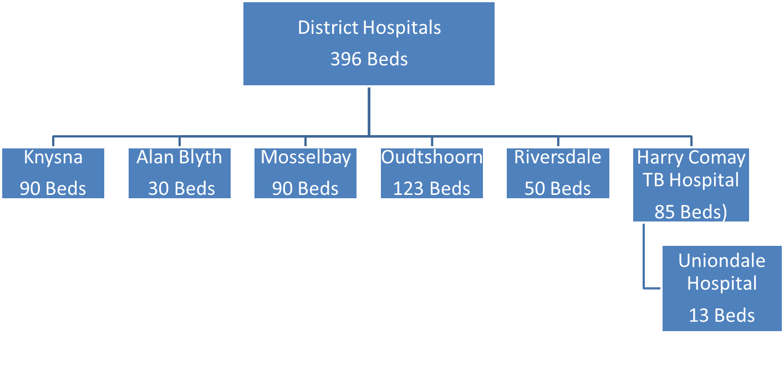
Hospital Services- Bed Allocation
George Regional Hospital
287 Beds

Slide 14
Total Health Facilities in the Garden Route District
Sub-district | Mobile | Satellite | Clinic | CDC | CHC | District hospital | Regional hospital | Central/tertiary hospital | TB hospital
Bitou | 2 | 1 | 4 | 1 | 0 | 0 | 0 | 0 | 0
George | 3 | 1 | 10 | 2 | 0 | 1 | 1 | 0 | 1
Hessequa | 3 | 3 | 3 | 0 | 0 | 1 | 0 | 0 | 0
Kannaland | 4 | 1 | 4 | 0 | 0 | 1 | 0 | 0 | 0
Knysna | 3 | 2 | 4 | 1 | 0 | 1 | 0 | 0 | 0
Mossel Bay | 4 | 7 | 3 | 2 | 0 | 1 | 0 | 0 | 0
Oudtshoorn | 3 | 0 | 5 | 1 | 0 | 1 | 0 | 0 | 0
District total | 22 | 15 | 33 | 7 | 0 | 6 | 1 | 0 | 1

Slide 15
Service Package and Offering
  Community Oriented Primary Care
  First 1000 days of life
  Sexual Reproductive Health (Family Planning)
  Ante-natal and obstetric services
  Child Health (Immunizations, Nutrition, School Health)
  Chronic Diseases of Lifestyle (DM, HT, COPD etc)
  Infectious Diseases: TB and HIV
  Emergency Centres: trauma
  Allied Health Services
  Mental Health Services

Slide 16
Priorities for Primary Health Care
Expand principle of ‘Community Oriented Primary Care’ (COPC) throughout district
Strengthening of multi-sectoral partnerships
Improving patient experience of care
Improvement in ‘Ideal Clinic’ outcomes (Office of Health Standards Compliance)
Formation of functional clinic committees
Establishing functional appointment systems

Slide 17
Priorities for Hospitals
Improvement in ‘Ideal Hospital’ outcomes (Office of Health Standards Compliance)
Ensure Emergency Centres are fully capacitated and functional
Implementation of ‘Principles for Safe Obstetric Services’ to reduce maternal mortality
Support EMS and HealthNet transport initiatives
Strengthen outreach support by specialist teams within the ecosystem aligned with efficient use of resources
Formation of functional health facility boards

Slide 18
Health Service Interventions – Focus 2023/24
First 1000 days of life
      Comprehensive package of care for Mother, Baby & Family from Conception to 2 years
      Community Health Workers walking the health journey with the family
      Paediatric Surge season surveillance- Whole of Society Approach needed.
Clinical Governance
      Development of Clinical Governance strengthening framework for the George ecosystem
      Connect Collaborate Co-create
Chronic Disease Management
Priority focus on Diabetes
      Clinical governance led by Family Physicians in collaboration with the multi-disciplinary team
      Using data information systems, identify healthcare users with raised HBA1c for targeted intervention
      Screening according to Western Cape Department of Health and Wellness guidelines

Slide 19
Health Service Interventions – Focus 2023/24
Strengthening of Mental Health services .
      Increased capacity. Additional resources (see table below)
      Establishment of a task team in response to increased incidence of suicides
      Collaboration with DSD and DBE to strengthen referral pathways and awareness
Garden Route Ecosystem
Garden Route District | 1 Psychologist (Oudtshoorn/Kannaland/ George)
George | 1 Registered Counsellor
Hessequa | 1 Social Worker
Knysna/Bitou | 1 Registered Counsellor (contract extended) 1Occupational Therapist
Mossel Bay | 1 Registered Counsellor (contract extended)
Oudtshoorn / Kannaland | 1 Social Worker

Slide 20
Health Service Interventions – Focus 2023/24
TB/HIV Services
      Improving data input to inform quality improvement plan
      Focus on clinical mentorship and governance
      New funding cycle NPO partners. Includes revised training module and service package
      Strengthening of linkage to care

Slide 21
5. Corporate Services Priorities

Slide 22
Corporate Service- Finance Interventions 2023/24
Training on new policies.
Expenditure management.
Asset management.
Special projects – 16B projects.
Procurement Planning.
Support to all components within the office.
Guide staff on the procurement processes.
Provide input on new policies, Delegations, and changes to accounting officer system (AOS).
Assist with new contracts.
Management of assets – Asset records:
Medium term forecast (MTF) Asset plans.
Procurement off Assets.

Slide 23
Corporate Service- People Management Interventions 2023/24
The People Management department of Garden Route District comprise of five main components namely:
- People Strategy;
- People Administration;
- People Development;
- Employee Health and Wellness and Employee Relations.
Each of these components have specific priorities on which they will be focusing on for 2023/2024.

Slide 24
Violence Prevention Unit/ Safety Promotion Coordination
Newly established unit.
Need to identify synergies and connections between various stakeholders.
ABT has a 3-pronged approach.
To identify hotspot areas and zoom into crime statistics.
Need for urban environmental design.
Violence prevention strategies needed.
Utilizing data to drive violence prevention initiatives.

Slide 25
6. Contracting Units for Primary Health Care (CUP)

Slide 26

CUP- Contracting Units For PHC in Knysna-Bitou Sub-district
What is a CUP?
A functional unit
Contract healthcare providers
Defined geographic area
Aligned to sub-district
District hospital catchment
(260 CUPs)
CUP is directly contracted by the fund
Function
Define catchment area
Develop epidemiological profile
Calculate capitation models
Accreditation of service providers
Contracting HC providers
Monitoring & Evaluation
Oversight and governance
Compliance monitoring
Book keeping
Implement HPRS
TOR & Scope
Code & cost benefits
Service determination
Determine service components WBOT, Specialist service, School Health program, etc)
Define legal status of CUP
Outline compliance requirements (PFMA & Treasury regulations)
Be responsible for health needs of population
*CUP to be further defined and clarified

Slide 27
7. NHI Aspects and Capital Projects

Slide 28
NHI Projects
1. The National Department of Health (NDoH) worked with the Provincial Department (PD) of Health to identify facilities which required refurbishments and upgrades.
Project Package | Estimated Budget | Estimated Practical Completion Date
Blanco Clinic and *Rosemoor Clinic | R11 337 570 | January 2025
Parkdene Clinic and Pacaltsdorp Clinic | R20 702 262.58 | January 2025
Albertinia Clinic, Riversdale Clinic and Riversdale Hospital | R22 161 094.26 | January 2025
Oudtshoorn Clinic, Dysselsdorp Clinic and Oudtshoorn Hospital | R53 185 467.98 | January 2025
*Due to the fire in June, this clinic is placed on hold. Allied health services de-escalated to Conville CDC

Slide 29
Capital Projects
Ladismith Clinic-Started with construction and well on its way. Expected completion date pushed to end of December 2023.
New Hornlee Clinic is in the conceptual design phase. Expected starting date May 2024.
George Road Satellite Clinic will be done by the Department of Health in partnership with the Department of Transport and Public Works. Awaiting further communication regarding the budget and scope of work to be done.
New Forensic Pathology Unit at Knysna Hospital is completed.

Slide 30
8. Inverter Projects

Slide 31
Inverters Program during phase 1
Completed:
Slangrivier Clinic
Eyethu Clinic
George Centrum Clinic
Amalienstein Clinic
Pending:
Asla Clinic
Bongolethu Clinic
Great Brak River Clinic
Knysna Town Clinic
Kuyasa Clinic
New Horizons Clinic
Zoar Clinic
Oudtshoorn Clinic

