Slide 1
Department of Economic Development and Tourism
IDP/Budget/PMS Rep Forum
Department of Economic Development and Tourism
23 November 2023

Slide 2
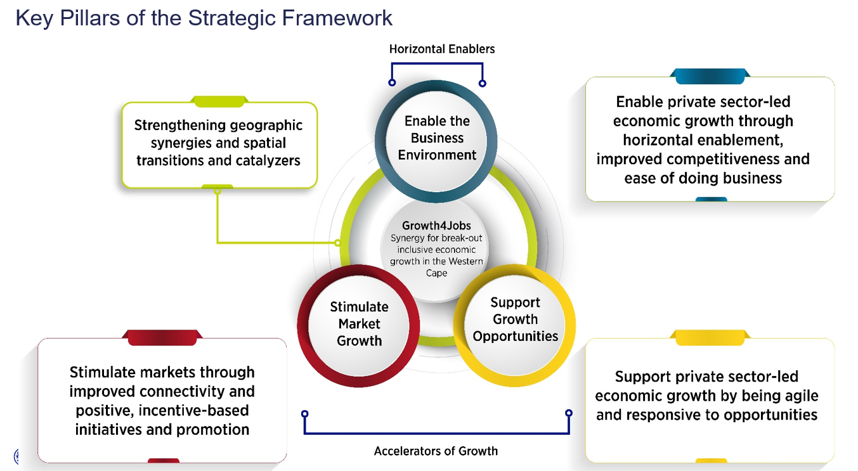
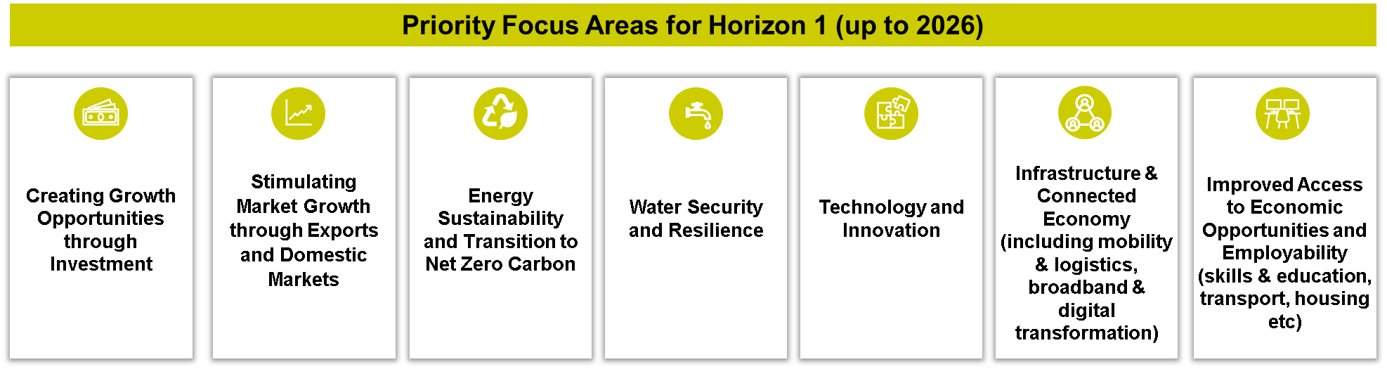
WESTERN CAPE Growth For Jobs 2035 STRATEGY (G4J)
Horizon 1 Priority Focus Areas flowing from Growth for Jobs
Strategic Framework
G4J GOAL: R1 TRILLION ECONOMY BY 2035 (Which means we must grow the WC economy by 4 - 6%p.a)

Slide 3
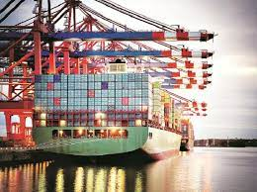



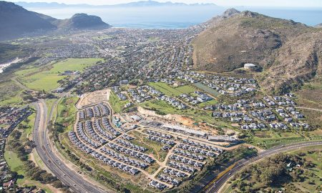
Our Priorities (2024 and medium term)
1 |  | 2 |  | 3 |  | 4 |  | 5
Employability: Skills |  | Exports |  | Investments |  | Employability: Entrepreneurship and Township |  | Ease of Doing Business: Red Tape Reduction
Ministerial priority |  | Ministerial priority |  | Ministerial priority |  | Ministerial priority |  | Ministerial priority
Tech & Innovation
Economic IQ
Communication and building the WC Brand

Slide 4
Departmental Priority Areas: Exports
Export Strategic Thrust 1
Export Strategic Thrust 2
Export Strategic Thrust 3
Increased awareness of opportunities & requirements in priority markets
Enhances competitiveness, sustainability and capabilities of exports
More efficient cost-effective export infrastructure (Port of CT)
Establish the WC as the leading global export region by tripling exports and doubling tourist arrivals
Tourism Strategic Thrust 1
Tourism Strategic Thrust 2
Tourism Strategic Thrust 3
Improved destination & industry accessibility through lobbying & advocacy; Airlift and Visa Reform
Enhanced destination management & building high performing businesses
Integrated Destination Marketing

Slide 5
Departmental Priority Areas: Employability – Entrepreneurship and Township
Strategic Thrust 1
Strategic Thrust 2
Enhance entrepreneurship pathways to build a strong entrepreneurial culture through supporting youth start-up businesses and leveraging existing digital entrepreneurial platforms
Effective business development
support for business growth and
Strengthened ecosystem through the SMME Booster Fund
Increase the entrepreneurial rate and capability of entrepreneurs through growing the SMME contribution in the WC
Strategic Thrust 3
Strategic Thrust 4
Entrepreneurship development through market access and funding through supplier development and access to funding initiatives
Bringing economic pathways
and opportunities closer to
citizens and communities through the implementation of the Township Economic Development programme

Slide 6
Departmental Priority Areas: Skills
Strategic Thrust 1
Strategic Thrust 2
Address the systemic challenges to close the gap between academia and private sector skills demands through amending and developing new curricula or modalities
Development and leveraging of partners in the skills ecosystem through the Premiers Council on Skills and Leveraging of funding initiatives
Improved access to economic opportunities and employability through improved capabilities of the youth workforce by creating 10 000 jobs
Strategic Thrust 3
Job creation through placement of beneficiaries for experiential learning employment opportunities, Skills development, Accreditations and Productivity pathways by expanding the clothing, tourism digital and BPO Experiential Work programme

Slide 7
Departmental Priority Areas: Ease of Doing Business- Red Tape Reduction
Strategic Thrust 1
Strategic Thrust 2
Advocate and Lobby for a more efficient and effective regulatory environment to make it easier to do business
Embed and institutionalise an EoDB culture by building capability through building capacity in Municipalities and the broader WC Government
To contribute to the WC becoming the easiest place to do business in Africa
Strategic Thrust 3
Provide direct support to businesses through the resolution of ad hoc delays

Slide 8

Departmental Priority Areas: Tech and Innovation
Strategic Thrust 1
Strategic Thrust 2
Strengthen Ease of Business & promote ecosystems of T&I through lobbying for critical reforms in Skills Visa and Exchange controls
Establish the WC as hub for venture capital, start-ups & scale-ups through providing productivity and innovation support to WC firms
To claim our position as the tech, start-up and venture capital and innovation and design capital of Africa
Strategic Thrust 3
Supporting human capital development in T&I through driving the tech pipeline in schools

Slide 9
EXISTING/PLANNED PROJECTS WITHIN GARDEN ROUTE DISTRICT (2023/24-2025/26)
Subject to MTEF Budgetary Process
Policy Priority or Policy Response | Municipal Area / Town | Timing/ Phasing of Project Allocation per Blue Book
 |  | 2024/25 R’000 | 2025/26 R’000 | 2026/27 R’000
Employability - Entrepreneurship (Incl. Township & Informal) Enterprise Development: Capital Matching Initiative and access to markets. Demand-driven support for SMMEs Enterprise Development: Booster Fund, Demand-driven support for SMMEs Entrepreneurship Culture Business development support Support post school ecosystem to celebrate entrepreneurship | No area specific allocation. Demand-led & evidence-led cases can apply through a competitive process. | 36 450 | 37 384 | 40 237
Employability – Skills Skills Development and Innovation - ssist in the provision of short-term job opportunities Provision of skilled labour | No area specific allocation. Demand-led & evidence-led cases can apply through a competitive process | 122 874 | 122 191 | 128 034
EODB - Red Tape Business Support Helpline Municipal Red Tape Reduction Support Lean Management | No area specific allocation. Demand-led & evidence-led cases can apply through a competitive process | 16 525 | 15 970 | 16 577
EODB - Office of the Consumer Protector Provide basic financial literacy interventions for Western Cape residents and businesses. Provide consumer complaints resolution services to Western Cape residents and businesses | Provincial-wide | 13 046 | 13 605 | 13 937
EODB - Regional and Local Economic Development Municipal capacity building Municipal economic growth plans Regional LED fora | No area specific allocation. Demand-led & evidence-led cases Provincial-wide

Slide 10
EXISTING/PLANNED PROJECTS WITHIN GARDEN ROUTE DISTRICT (2023/24-2025/26)
Subject to MTEF Budgetary Process
Policy Priority or Policy Response | Municipal Area / Town | Timing/ Phasing of Project Allocation per Blue Book
 |  | 2024/25 R’000 | 2025/26 R’000 | 2026/27 R’000
Export and Domestic Markets (including Tourism) Export Competitiveness Enhancement Programme District export awareness campaigns Tourism Signage Skills Development Tourism Safety: Tourism Law Enforcement Unit Tourism Growth and Development: G4J Tourism Challenge Fund Quality Assurance Support to Regional and Local Tourism Offices | No area specific allocation. Demand-led & evidence-led cases can apply through a competitive process | 133 803 | 131 753 | 135 774
Economic IQ Promote and co-ordinate economic IQ within the Province | Provincial-wide | 17 621 | 17 124 | 18 445
Driving Investment Atlantis Special Economic Zone | CCT, Atlantis | 105 071 | 102 009 | 105 682

Slide 11
Tel: +27 21 483 9378| Cell: +27
Fiona.Mabuya@westerncape.gov.za
www.westerncape.gov.za

