Slide 1
Results
Garden Route

Slide 2
ABOUT STATS SA
CENSUS MANDATE
Stats SA is a national government department accountable to the Minister in the Presidency: Planning, Monitoring and Evaluation.
The activities of the department are regulated by the Statistics Act (6 of 1999) which mandates the department to advance the production, dissemination, use and coordination of official statistics to advance planning, monitoring and decision making to advance economic growth, development and democracy.
Section 7 of the Statistics Act: The Statistician-General must cause a population census to happen.

Slide 3
What are some of the key Census 2022 innovations?
WHY IS A CENSUS IMPORTANT?
Equity in distribution of government services
The Census generates diverse data on demographic and socio-economic information and plays an essential role in planning, policy formulation, evaluation and budget allocation.
Distributing and allocating government funds among various regions and districts for services
Measuring the performance impact of socio economic development of government policies and programmes

Slide 4





The road to Census 2022
1996 Traditional face-to-face census visiting households with paper questionnaire
2001 Census enumerators visiting households with paper questionnaire
2011 Traditional face-to-face census visiting households with paper questionnaire, Questionnaire scanning
2022 100% digital, multi-mode options of data collection:
        Face to face (CAPI)
        Telephonic (CATI)
        Web-based (CAWI)

Slide 5
Our Journey
Aug 2018
Dec 2020
New Methodologies Test (NMT)
Pilot postponed COVID -19 Wave 2 (CAWI, CAPI,CATI)
Jul 2021
Jul 2020
Pilot Conducted (Except in KZN and WC)
(CAWI, CAPI,CATI)
Census Trial
COVID -19 Wave 1
Fully implemented
Remotely
CAWI, CATI
2019
Feb 2022
LGE Decision
23 Jul 2022
Pilot 2 Main
Sep-Nov 2021
3 months
Main Census Conducted
(CAWI, CAPI,CATI)
Mini Test Phase 1 + 2 (CAPI)

Slide 6
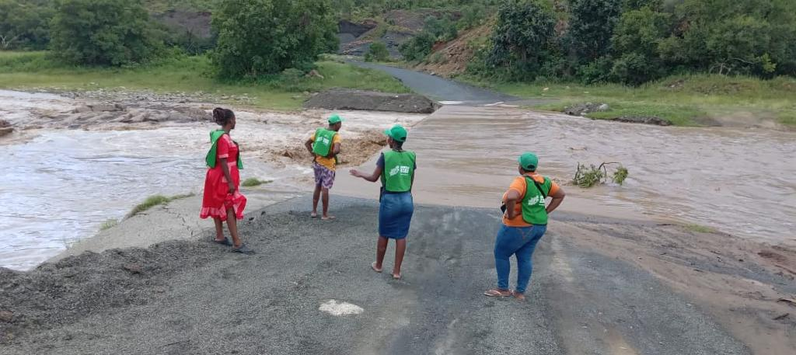
What are some of the key Census 2022 innovations?
Background
Statistics South Africa’s first digital census
COVID-19 pandemic biggest census project disruptor:
Pilot
Main census
Census planning and implementation affected
Shifting of Census reference point from October to February
Possible impact on indicators
Multi modal data collection approaches:
CAPI, CAWI, CATI
Changes in training mode to mitigate impact
Extended enumeration period
Staggered enumeration completion

Slide 7
What are some of the key Census 2022 innovations?
KEY CENSUS 2022 INNOVATIONS
Web and telephone mode options for households who registered
This was South Africa’s first digital census with real time, computer aided data collection using hand held devices
Online fieldworker verification system
Localised Recruitment with Integrated Google Maps
SOPs for managing COVID-19 in the field

Slide 8
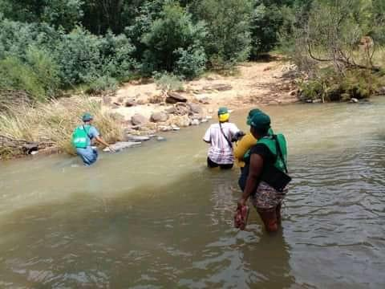
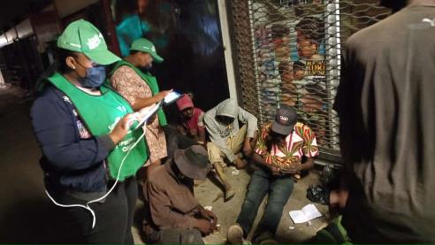
What are some of the key Census 2022 innovations?
CENSUS ENUMERATION
2 FEBRUARY 2022
Stats SA conducts a de facto census, which means individuals are counted according to where they were on the census night:
2nd February 2022.
Those living in special dwelling institutions as well as the homeless and transient were counted.
Enumeration of the rest of the country started on 3rd February and was finalised between March and 31 May 2022

Slide 9
What are some of the key Census 2022 innovations?
Quality Matters
Data quality assurance processes built in all census phases including:
  In-built validation rules in data collection instruments;
  Fieldwork monitoring throughout enumeration period;
  Minimal editing and imputations;
  Use of independent technical experts to evaluate census 2022 processes and data;
  Validation of census 2022 data against previous censuses.

Slide 10
Quality Matters: Data Collection Rate

Slide 11
Undercount – Persons and households
Province | Net undercount rate for persons (%) | Net undercount rate for households (%)
Western Cape | 35,58 | 36,30
Eastern Cape | 32,40 | 27,24
Northern Cape | 33,41 | 27,14
Free State | 20,95 | 17,93
KwaZulu-Natal | 34,67 | 27,93
North West | 23,33 | 23,05
Gauteng | 30,79 | 35,82
Mpumalanga | 35,26 | 32,00
Limpopo | 23,53 | 24,83
RSA | 31,06 | 30,49
United Nations acclaimed methods used to identify those omitted or counted more than once during Census taking.
The persons that were missed were accounted for and the count adjusted.
The same UN methods, are used to
  Assure quality of key variables and
  check the veracity of our data.

Slide 12
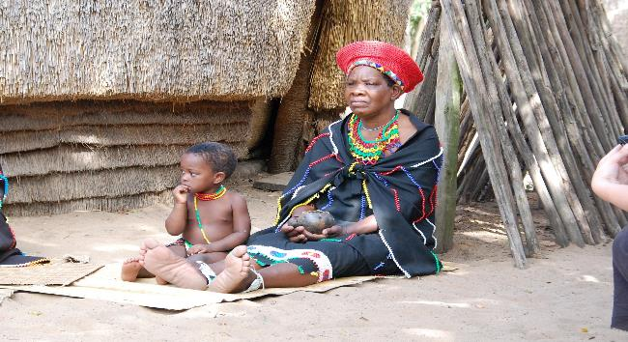


Population

Slide 13


South Africa’s Population on 2 February 2022
62,027,503

Slide 14
South Africa’s population increased by 19,8% from 2011 to 2022
Increase by 19,8% from 2011
10,3 Million Increase

Slide 15
Garden Route’s Population on 2 February 2022
838,457

Slide 16
Garden Route has grown by 264192
Population by Province 2022
All municipalities showed growth between 2011 and 2022
16

Slide 17

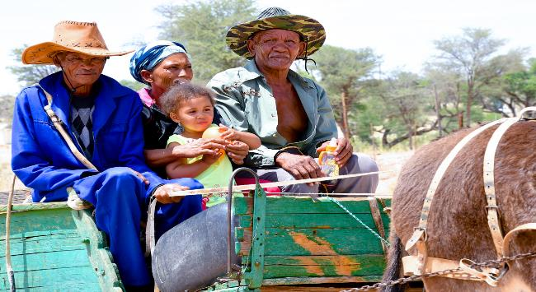
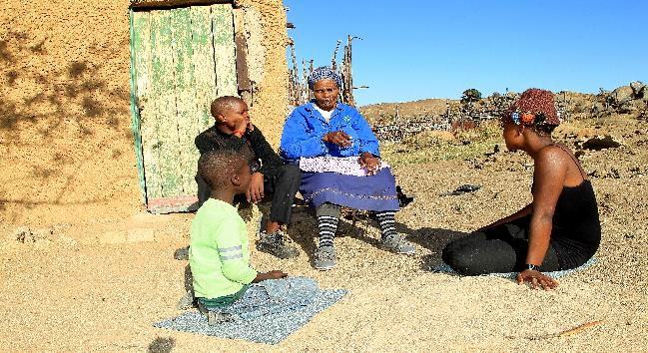
Demographics

Slide 18
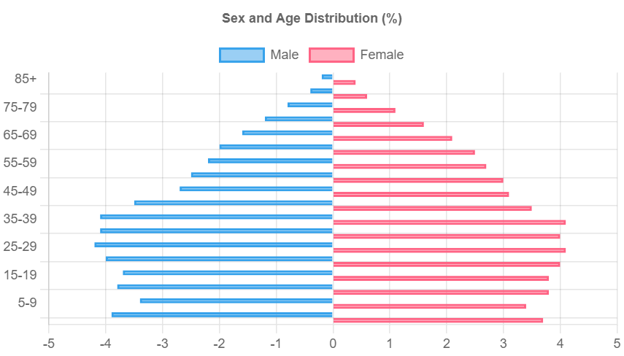
Females constituted 51.4% of the total population while 48.6% were males. As age increases women outlive their male counterparts
Population by 5-year age groups and sex, Census 2022
51.4%
48.6%
Age Group
All Ages

Slide 19

Coloured population group constitutes the largest proportion of Garden Route’s population, followed by Black African at 27.8%
416542
232882
164589
Coloured
Black African
White
19.6%
49.7%
27.8%
21335
2816
Other
Indian/Asian
2,5%
0.3%
19
*Due to rounding totals may not add up to 100%

Slide 20
53.9% of Garden Route’s population is under 35 years old
Population age structure 5-year age groups, 2022
Elderly 60+
123775
Children 0-14
185779
Youth 15-34
266976
Adults 35-59
261902
22.0%
31.9%
31.4%
14.5%
*Due to rounding totals may not add up to 100%

Slide 21
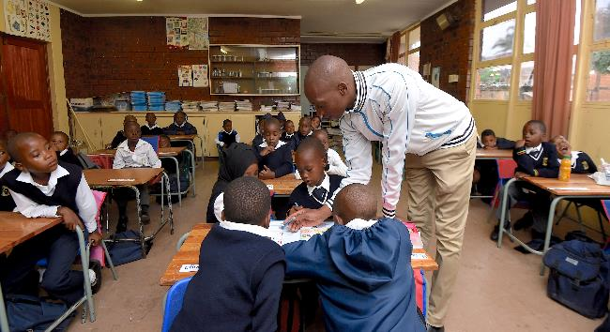

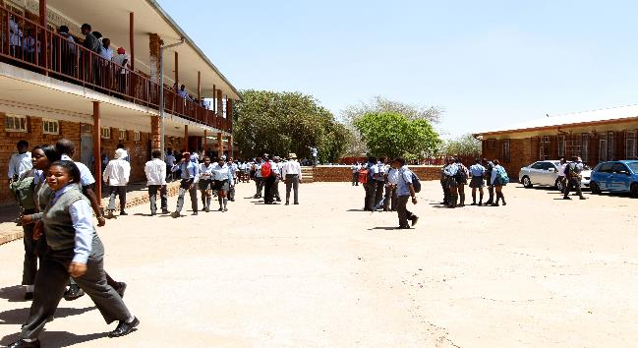
Education

Slide 22
Persons aged 5–24 years attending school in Garden Route
Population aged 5–24 by school attendance by age, Census 2022
N = 240705
1996

Slide 23
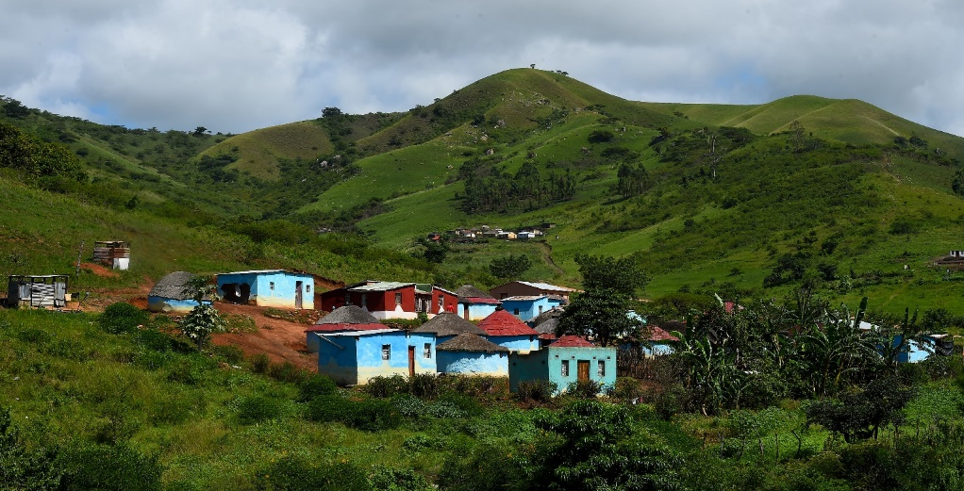
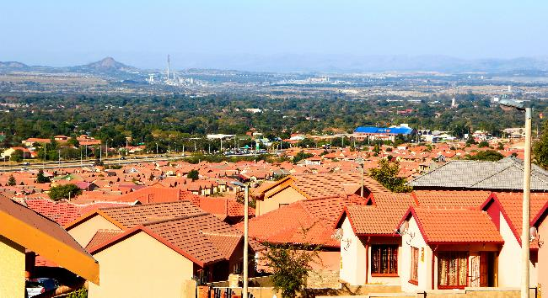
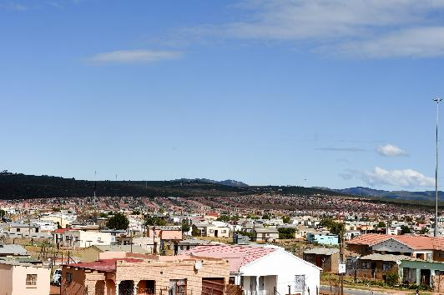
Housing and Households

Slide 24
17,8 million households in Census 2022
Households Census 1996–2022
HOUSEHOLDS
Since 1996, the number of households almost doubled
Increase by 23,7% from 1996
Increase by 28,9% from 2001
Increase by 23,4% from 2011

Slide 25
Households that resided in formal dwellings were 89,0% in 2022
Average household size = 3.3
Households by type of main dwelling, Census 2022

Slide 26
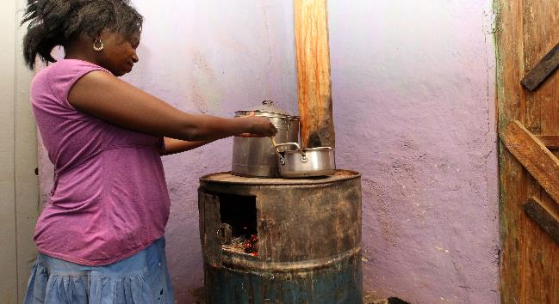
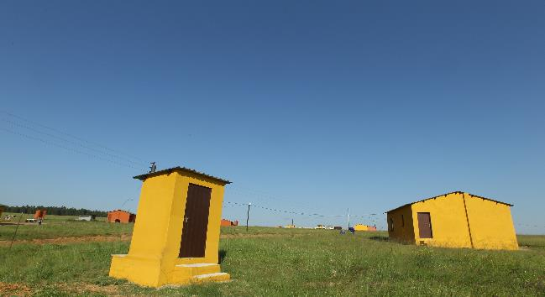
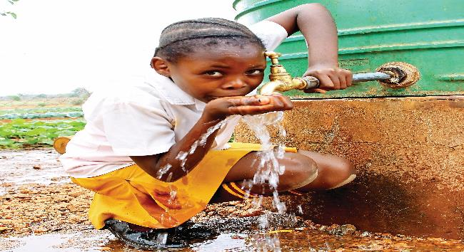
Service Delivery

Slide 27
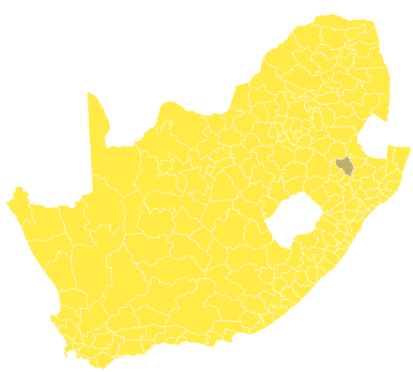
Access to electricity for lighting in Garden Route in 2022
had 92.3% of households having access to electricity for lighting
2022
Households by access electricity for lighting by municipality, Census 2022

Slide 28
Access to electricity for cooking in Garden Route in 2022
Oudtshoorn had almost two thirds of households having access to electricity for cooking and less than a third using gas
2022
Households by access electricity for cooking by municipality, Census 2022

Slide 29
Access to electricity for cooking in Garden Route in 2022
 | Electricity from mains | Gas | Paraffin | Wood | Coal | Animal dung | Solar | Other | None
Garden Route | 161550 | 86235 | 3069 | 3430 | 56 | 13 | 577 | 366 | 680
Kannaland | 5896 | 2184 | 5 | 517 | 2 | 2 | 49 | 8 | 23
Hessequa | 15879 | 6151 | 5 | 154 | 3 | 0 | 84 | 21 | 35
Mossel Bay | 32313 | 19995 | 276 | 152 | 6 | 6 | 82 | 50 | 104
George | 52777 | 30008 | 1913 | 571 | 25 | 3 | 159 | 173 | 303
Oudtshoorn | 20463 | 9320 | 211 | 1534 | 13 | 0 | 111 | 52 | 91
Bitou | 14954 | 6725 | 58 | 47 | 2 | 0 | 31 | 14 | 17
Knysna | 19267 | 11852 | 602 | 455 | 5 | 2 | 61 | 48 | 107
Households by access electricity for cooking by municipality, Census 2022

Slide 30
In 2022, 93.7% of households in Garden Route had access to piped water either inside their dwelling or inside their yard
Households by access to piped water, Census 2022
Piped water inside dwelling now the dominant method of receiving piped water
No access to piped water
8,8%
8,7 %
19,7%
15,5%
8,9%
Piped water outside yard/on community stand
17,9%
19,6%
23,2%
Piped water inside yard
Piped water inside dwelling

Slide 31
Households using flush toilets in Garden Route 2022
Households by type of toilet facility households by type of toilet facility, Census 2022
Bucket toilet for 2022 includes Bucket toilet collected by municipality and Bucket toilet emptied by household. Other for 2022 includes Ecological toilet

Slide 32
Approximately 88.8 %of households in the country had their refuse removed by a local authority once a week
Households by type of refuse disposal utilised, Census-2022

Slide 33
What are some of the key Census 2022 innovations?
Phase 1: National and provincial launch include selected indicators disseminated at national, provincial and municipal levels.
List of products:
Statistical Release
Provinces @ a Glance
How the count was done
Tables
PHASED DATA RELEASE
Phase 2: Data to be released to public including lower levels of geography: community profiles and small area layer.
List of products: Products be released in a staggered approach
Electronic products including SuperCross and superweb
10% Sample
Theme based monographs/indepth reports

Slide 34



Census 2022
Enkosi!
statssa.gov.za
twitter.com/StatsSA
facebook.com/StatsSA

